Slide 1

Zero-Code Acceleration for Data Science
A Comparative Study of Pandas, Modin, Intel® oneAPI, and NVIDIA RAPIDS

Slide 2
TEAM MEMBERS:- Manvith Reddy Kandi(24BCE10177) Simone Gupta(24BCE10618) Divyansh Sharma(24BCE11197) Kanakiya Dip D. (24BCE11205) Akhand Pratap Singh(24BCE11467)
UNDER GUIDANCE OF – Dr. Pavithra Rathinavel

Slide 3

Introduction
Data science workflows are often slow, limiting productivity and innovation.
The cause is that standard libraries like Pandas and Scikit-learn were designed for a single-core world and don’t fully utilize modern multi-core CPUs or GPUs.
Our goal: accelerate workflows significantly with minimal to zero code changes.

Slide 4

01
Presentation Overview

Slide 5

Background and Motivation
Data scientists spend valuable time waiting for code execution instead of analyzing results.
We aim to overcome this bottleneck by using acceleration libraries that require no or minimal code changes.
The investigation focuses on commonly used tools and how they can enhance workflow efficiency.

Slide 6
Experiment Setup and Tools
Workflow benchmark: load a 1-million-row CSV (NYC Taxi dataset), perform groupby aggregation, train a RandomForestClassifier.
Contenders include:
- Baseline: Standard Pandas + Scikit-learn on CPU
- Modin: drop-in replacement for Pandas with multi-core CPU acceleration
- Intel® oneAPI: CPU extension to speed up Scikit-learn
- NVIDIA RAPIDS: GPU-based acceleration using cudf and cuml libraries

Slide 7
Key Results and Insights
RAPIDS shows fastest execution across tasks, harnessing GPU power.
Modin improves data processing speed easily with minimal code change.
Intel® oneAPI offers model training speedup on CPUs with small code patch.
Each tool presents trade-offs between speed gains and implementation complexity.

Slide 8

02
Data Science Bottleneck

Slide 9

Problem Definition
Traditional data science tools designed for single-core processing limit exploitation of modern CPU and GPU architectures.
This causes slow execution times, limiting productivity and timely insights.
The challenge is to accelerate workflows without extensive rewriting or parallel programming expertise.

Slide 10
Workflow Steps and methodology
The typical workflow involves three key stages:
- Data loading (reading large datasets)
- Data processing (groupby aggregations, transformations)
- Model training (machine learning algorithms such as RandomForest)
Each step offers opportunities for acceleration with appropriate tools.

Slide 11
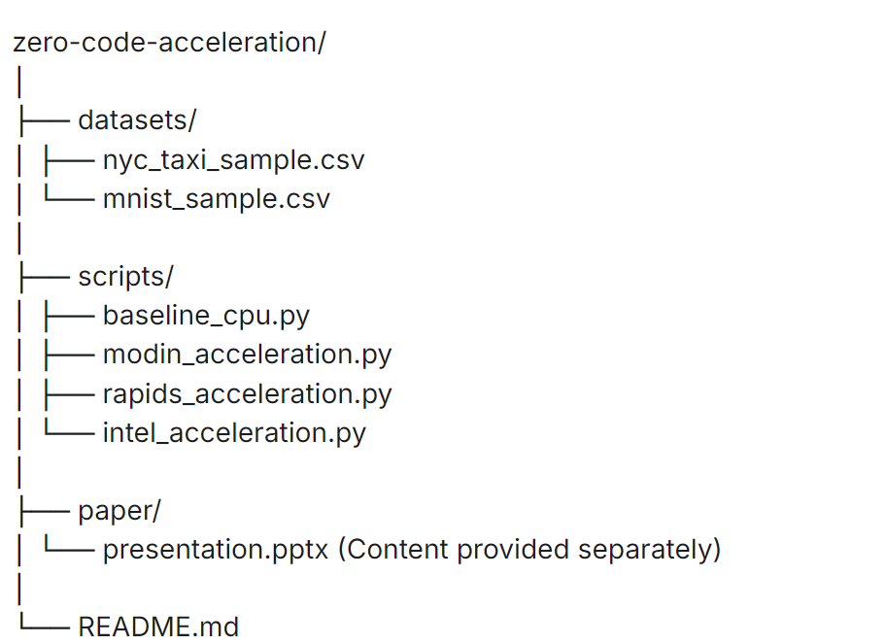
SYSTEM ARCHITECTURE DIAGRAM:-

Slide 12
Impact on Productivity
Slow runtimes keep data scientists waiting, reducing focus on analysis and model improvement.
Faster workflows enable more iteration, testing, and better model outcomes.
Acceleration tools can reclaim valuable time, increasing innovation speed and output quality.

Slide 13
Impact on Productivity
Slow runtimes cause data scientists to spend excessive time waiting for code to execute, reducing analysis time.
Faster execution enables more iterations, better model tuning, and faster delivery of insights.
Acceleration tools reclaim valuable time, significantly improving innovation speed and output quality.
This leads to higher productivity and more impactful data science outcomes.

Slide 14

03
Acceleration Tools and Implementation

Slide 15
Modin: Easy Integration for Data Processing
Modin is a drop-in replacement for Pandas requiring only a single import change.
It uses multi-core CPU parallelism to speed up data loading and manipulation.
No other code changes are needed, making it an effortless acceleration tool for typical workflows.

Slide 16
Intel® oneAPI: CPU-based Model Training Improvement
Intel® oneAPI accelerates Scikit-learn model training on CPUs with a simple two-line patch.
It delivers around 2x speedup in model training without modifying data processing steps.
Ideal for CPU-dependent machine learning workflows requiring faster training times.

Slide 17

NVIDIA RAPIDS: GPU-based Comprehensive Acceleration
RAPIDS is a library suite that enables GPU acceleration of the entire workflow.
It requires switching to GPU-specific libraries but delivers the fastest runtime improvements.
It provides 6-8x speedups for data loading, processing, and model training when using NVIDIA GPUs.

Slide 18

04
Performance Analysis and Recommendations

Slide 19

Execution Time Comparisons
Execution times show RAPIDS as the fastest, followed by Modin and oneAPI.
Data loading times: RAPIDS 0.4s, Modin 1.8s, Baseline 3.2s.
GroupBy operations: RAPIDS 0.2s, Modin 0.9s, Baseline 1.5s.
Model training: RAPIDS 4.2s, oneAPI 14.3s, Baseline 28.7s.

Slide 20
Speedup Visualization and Interpretation
Speedup factors compared to baseline demonstrate RAPIDS leads with 6-8x improvements.
Modin provides 1.5-2x speedups in data processing tasks.
Intel® oneAPI offers a 2x speedup for model training.
These gains translate to significant workflow acceleration depending on the bottleneck.

Slide 21
Implementation and coding (MODULE WORKFLOW): LINK:-ACC_layout.docx

Slide 22
DEMO VIDEO:- LINK:-
DEMO VIDEO ON ZERO CODE ACCELERATION.

Slide 23
SNAPSHOTS OF THE PROJECT WITH TESTING(INPUT/OUTPUT):- LINK:-SNAPSHOTS OF PROJECT.docx (INPUT AND OUTPUT ARE GIVEN IN THE SNAPSHOTS)

Slide 24
RESULTS:- Tool Selection Based on Workflow Needs
Choose RAPIDS for maximum speed if you have an NVIDIA GPU and can adapt code.
Select Modin for simple, no-code changes accelerating CPU data processing.
Use Intel® oneAPI to speed up CPU-based model training with minimal code addition.
Hybrid approaches combining Modin and oneAPI can optimize CPU workflows effectively.

Slide 25

Conclusions
Accelerating data science workflows no longer requires deep parallel programming skills.
Powerful tools like Modin, oneAPI, and RAPIDS offer dramatic runtime reductions with minimal code effort.
Selecting the appropriate tool depends on hardware availability and workflow bottlenecks.
Adopting these solutions can unlock faster iterations, higher productivity, and improved business outcomes.

